Slide 1
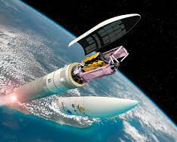
AE 238
Payload fairing and payload adaptor

Slide 2
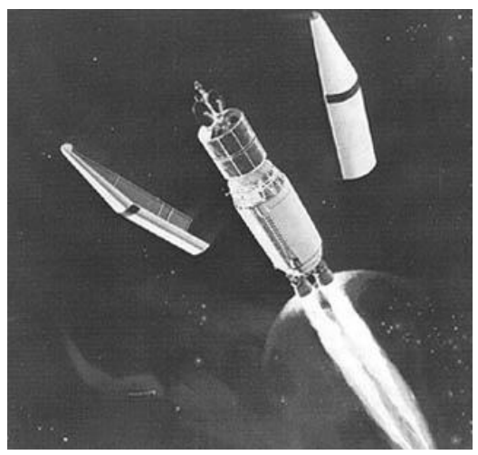
Payload fairing
A spacecraft is subject to various factors, including dynamic pressure and aerodynamic heating due to the atmosphere during its launch.
To protect the payload during the pre-launch operations and during the initial flight stages, a nose cone, commonly called Payload Fairing (PLF) is used in the forward most section of the launch vehicle.

Slide 3
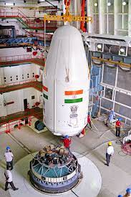
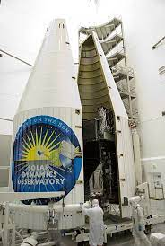
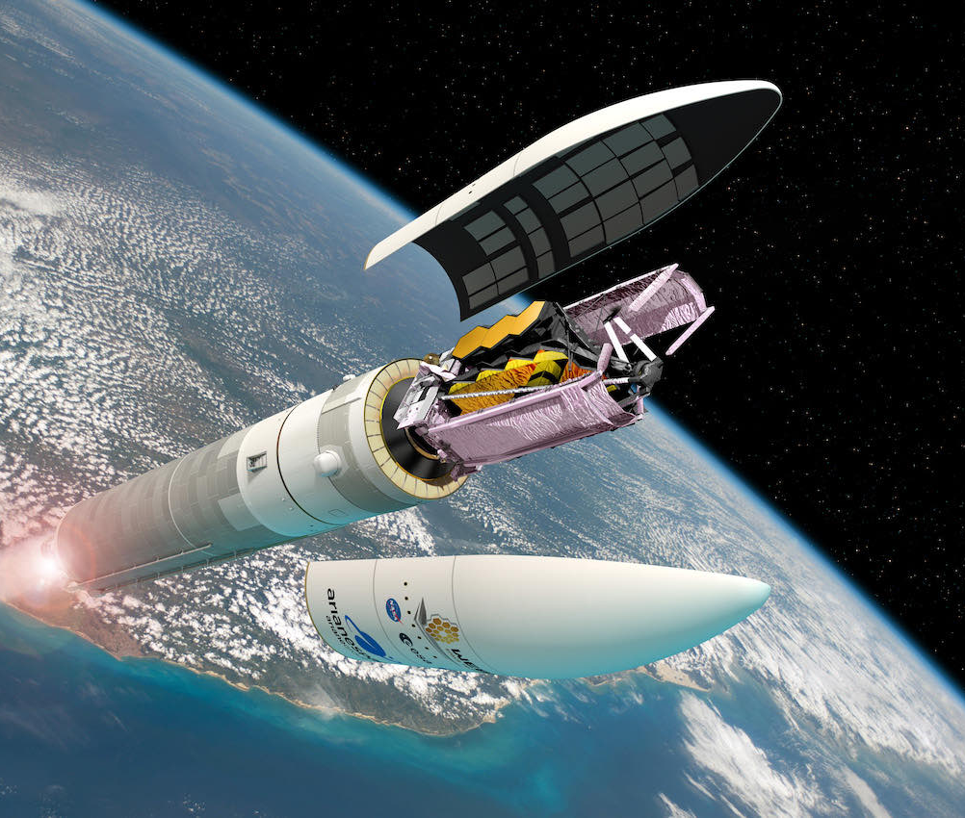
Why PLF is required?
PLF configuration must be such that it accommodates maximum possible payload and maintains aerodynamic shape to keep the launch vehicle loads much below the design load.

Slide 4
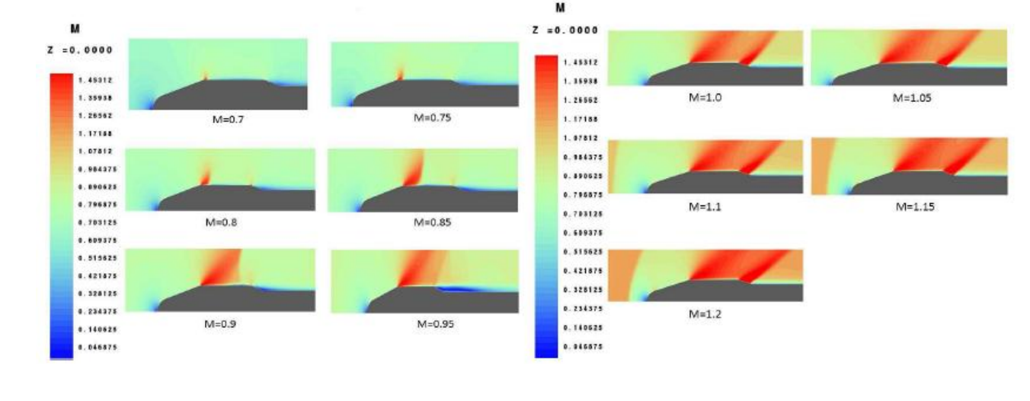
Flow analysis over a PLF
Flow separation does not take place for low Mach numbers in the transonic regime and there is a short separation for Mach numbers in the range 0.85 to 0.9.
flow separation does not take place when the Mach number is between 1.0 and 1.2.
flow separation length is longer as Mach number increases and the shockwave moves in boattail region at Mach number 0.95

Slide 5
Conclusion for flow analysis of PLF
For lower transonic Mach numbers, flow separation occurs and for higher Mach numbers in the transonic regime, shock is formed, but no shock induced separation occurs.
Near the cone cylinder region, expansion waves are formed and they increase with the Mach number. It is also observed that as Mach number increases from 0.7 to 0.95, the shock strength reduces hence the shock waves strength also varies with the Mach number.

Slide 6
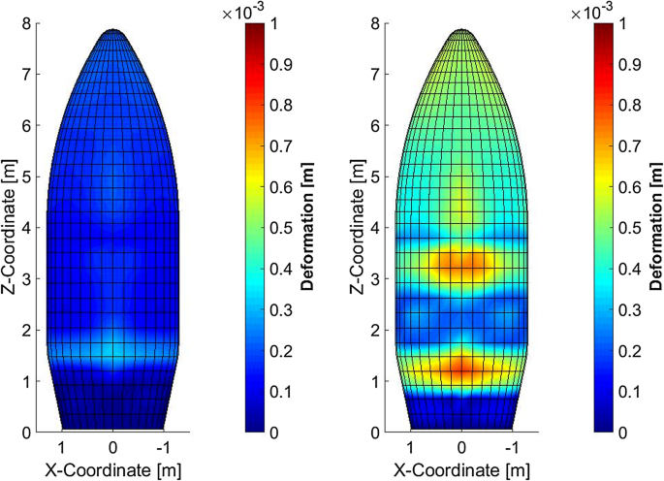
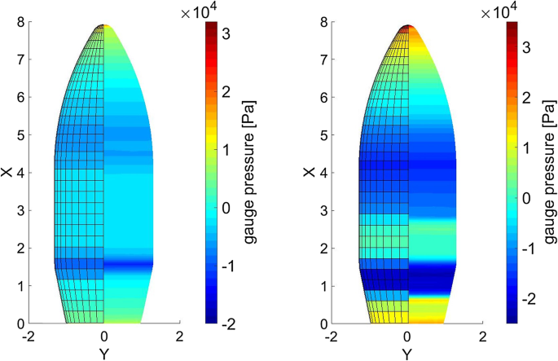
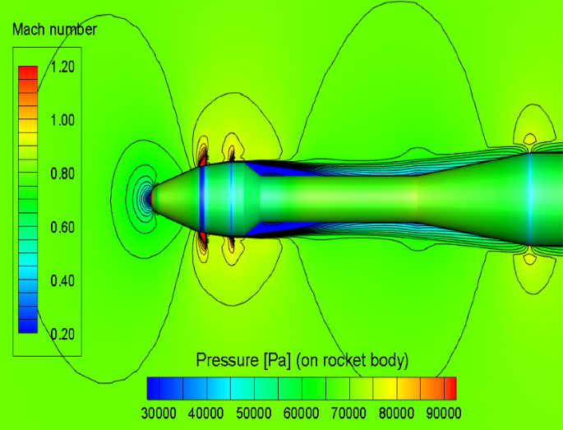
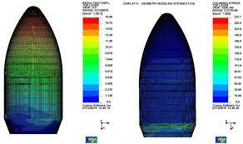
Structural analysis of PLF
Pressure distribution can be found out by using flow analysis for different Mach numbers, corresponding pressure loads can be used to do a detailed structural analysis on the PLF.

Slide 7
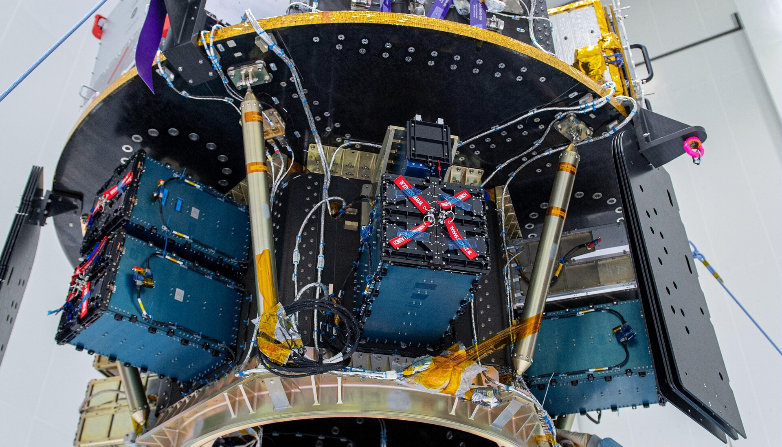
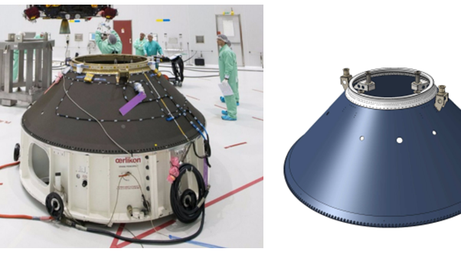
Payload Adaptor
A more structural viewpoint can be given to the Payload Adaptor, as PLF is more concerned with the aerodynamics.
attachment of the spacecraft or satellite to the rocket launcher structure is normally performed through an adapter.
Major loadings are applied to the adapter structure during the injection of the payload into an orbit. The intensity of these loadings depends on the mass of the payload and the longitudinal and transverse g-forces

Slide 8
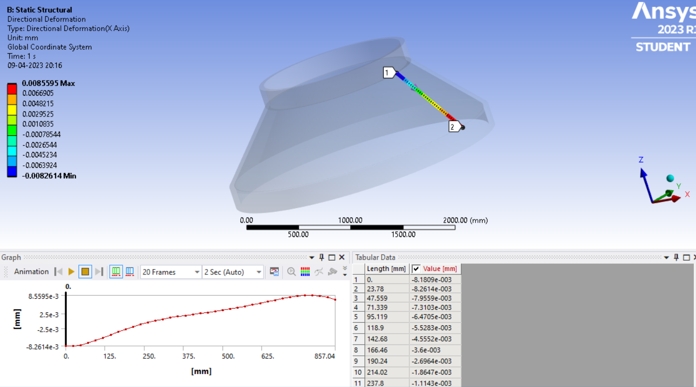
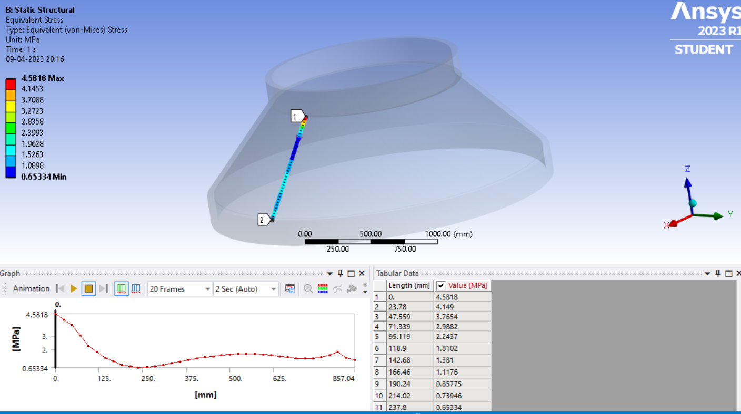
Analysis for different geometry

Slide 9
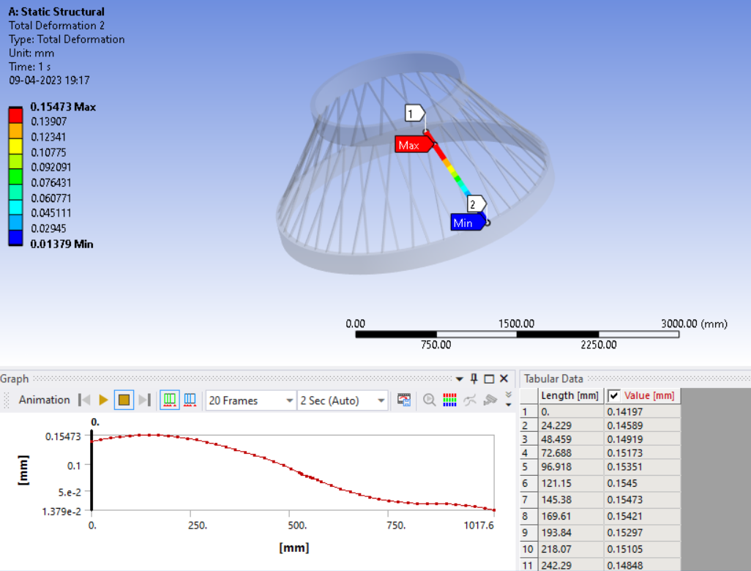
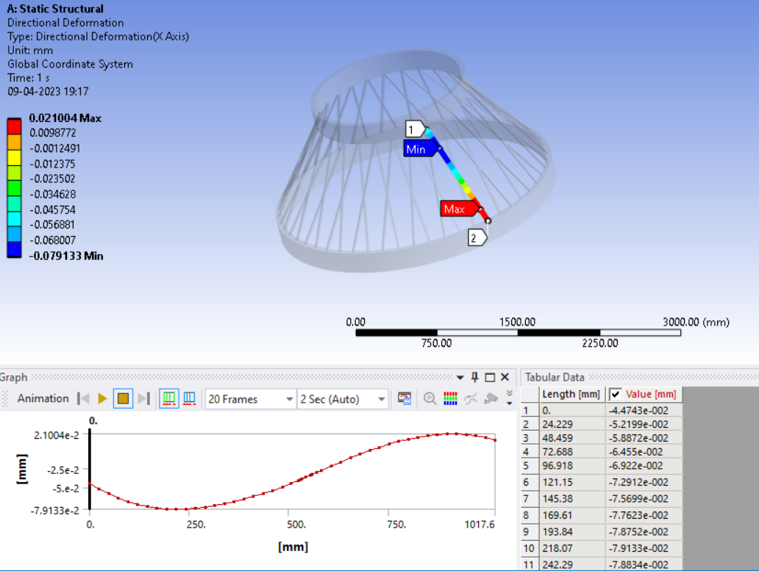
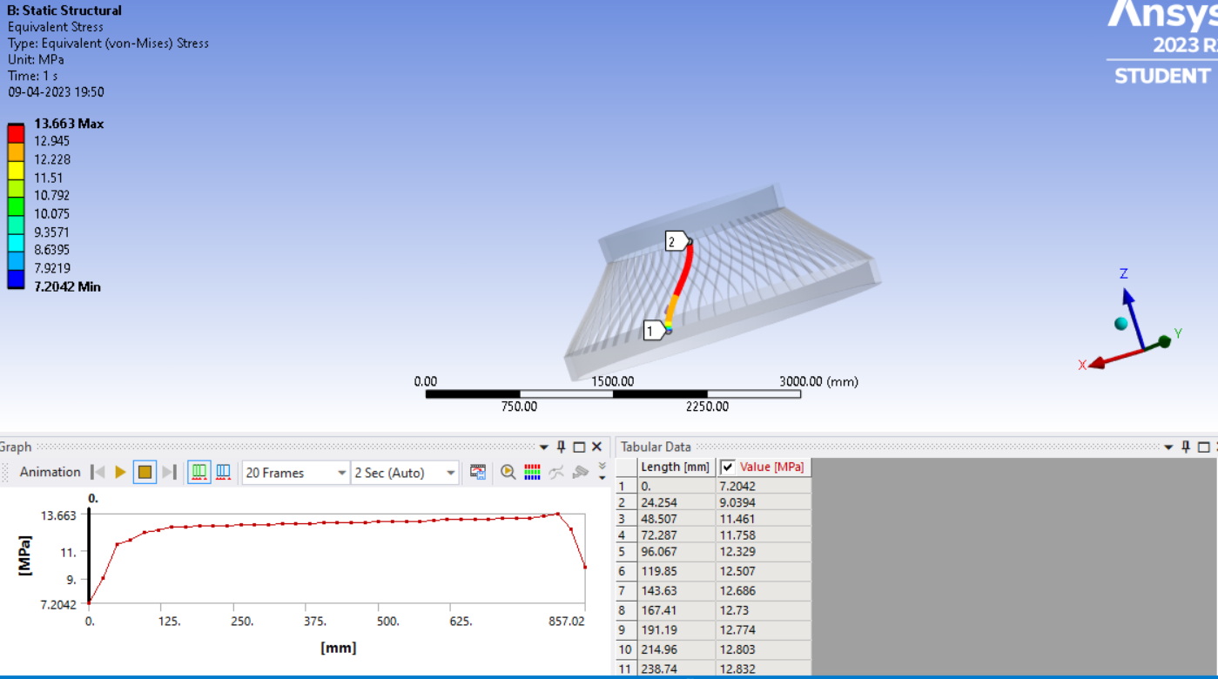
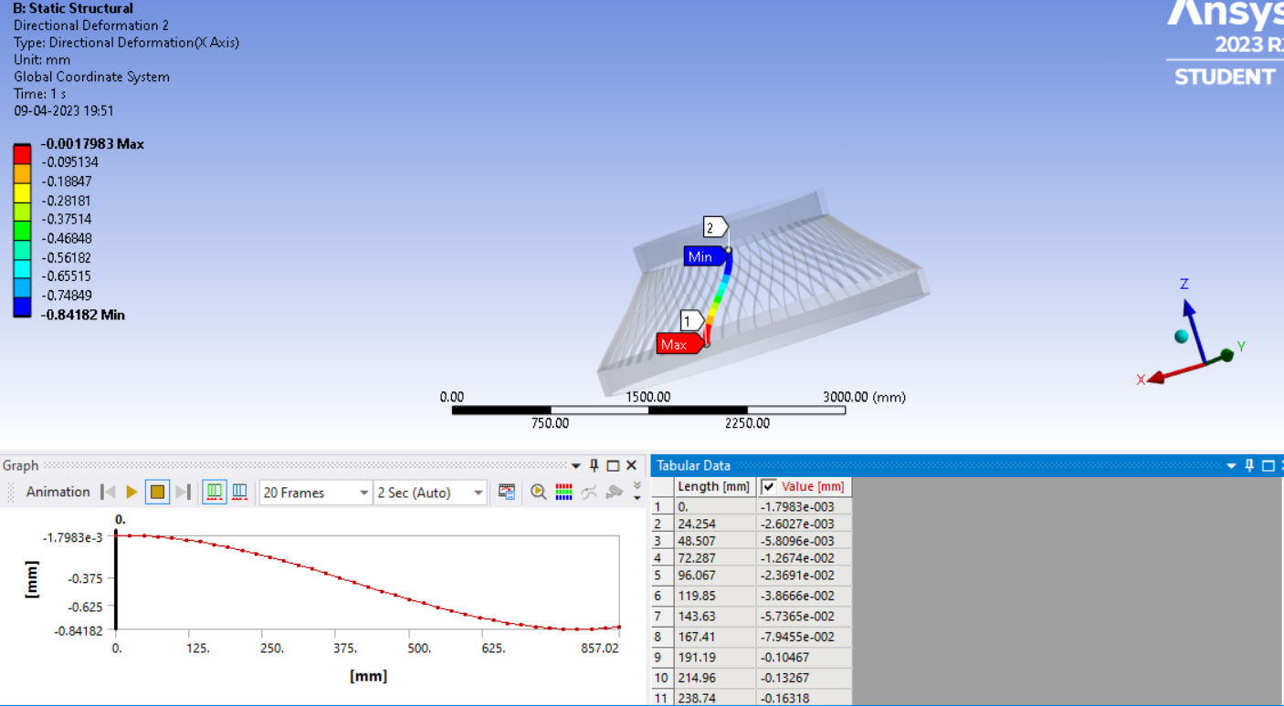
Payload Adaptor structural analysis

Slide 10
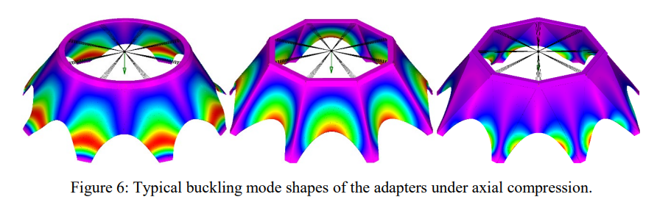
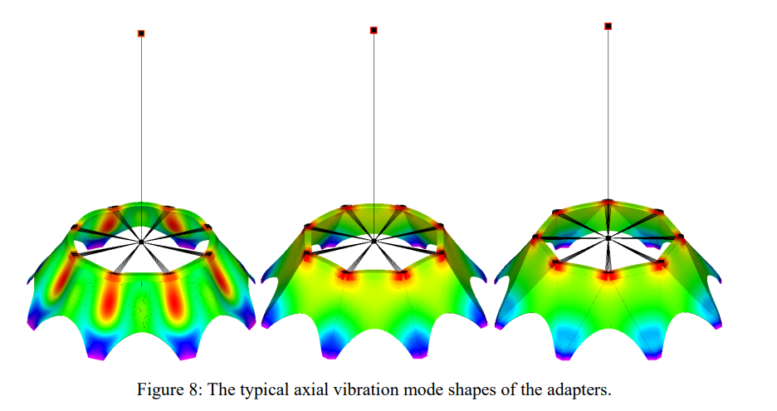
More analysis for different adaptors
Analysis of adaptor shown is the latest one in use.

Slide 11
Conclusion on payload adaptor analysis
Payload adaptor’s structure has a more structural importance, as it has to carry the weight of the satellite on it.
Our aim for the structure of PLA is to have less instabilities in the structure as possible which includes buckling etc.
Also, less deformations are preferred and also for the stress to not pass the elasticity range.
Effects of vibration modes, aeroelasticity etc. are also considered in the true structural analysis.

Slide 12
Thank You!
Sahil Nitin Kale(210010054),
Vivek Parsana(210010047),
Yashodhan Tingne(210010065),
Keyur Bagadiya(210010019)
Vivek Grover(210010075)

